Slide 1
Healthify: AI driven Food Ingredient Analysis for Heath Management
Submitted in the partial fulfillment for the award of the degree of
BACHELOR OF ENGINEERING
IN
Artificial Intelligence And Machine Learning
Presented by:
Sumit 21BCS6738
Department of AIT-CSE
DISCOVER . LEARN . EMPOWER

Slide 2
Outline
Introduction to Project
Dataset Used
Objectives
Methodology used
Results and Outputs
Conclusion & Future Scope

Slide 3
Introduction to Project
In today’s rat race of getting all desires fulfilled. Human has ignored the most expensive part of their life --- their Health.
People has ignored their health to that extent that they don’t ever bother what they are consuming.
As a result, most of the population is suffering from fatal diseases like Diabetes in India.
The Market is full of packaged food products having hazardous ingredients.
To solve this problem, here is the quick and accurate companion, Healthify: AI Model

Slide 4
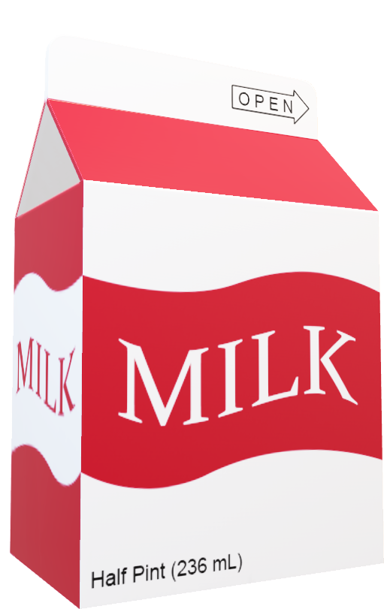
Dataset
For better analysis, the dataset is up to date and gathered in real time manually
It includes 12 food categories:
Snack Foods
Ready-to-Eat Meals
Frozen Foods
Dairy Products
Confectionery and Desserts
Beverages
Staples and Cooking Essentials
Breakfast Cereals
Health and Wellness Foods
Bakery and Breads
Condiments and Sauces
Baby Foods

Slide 5
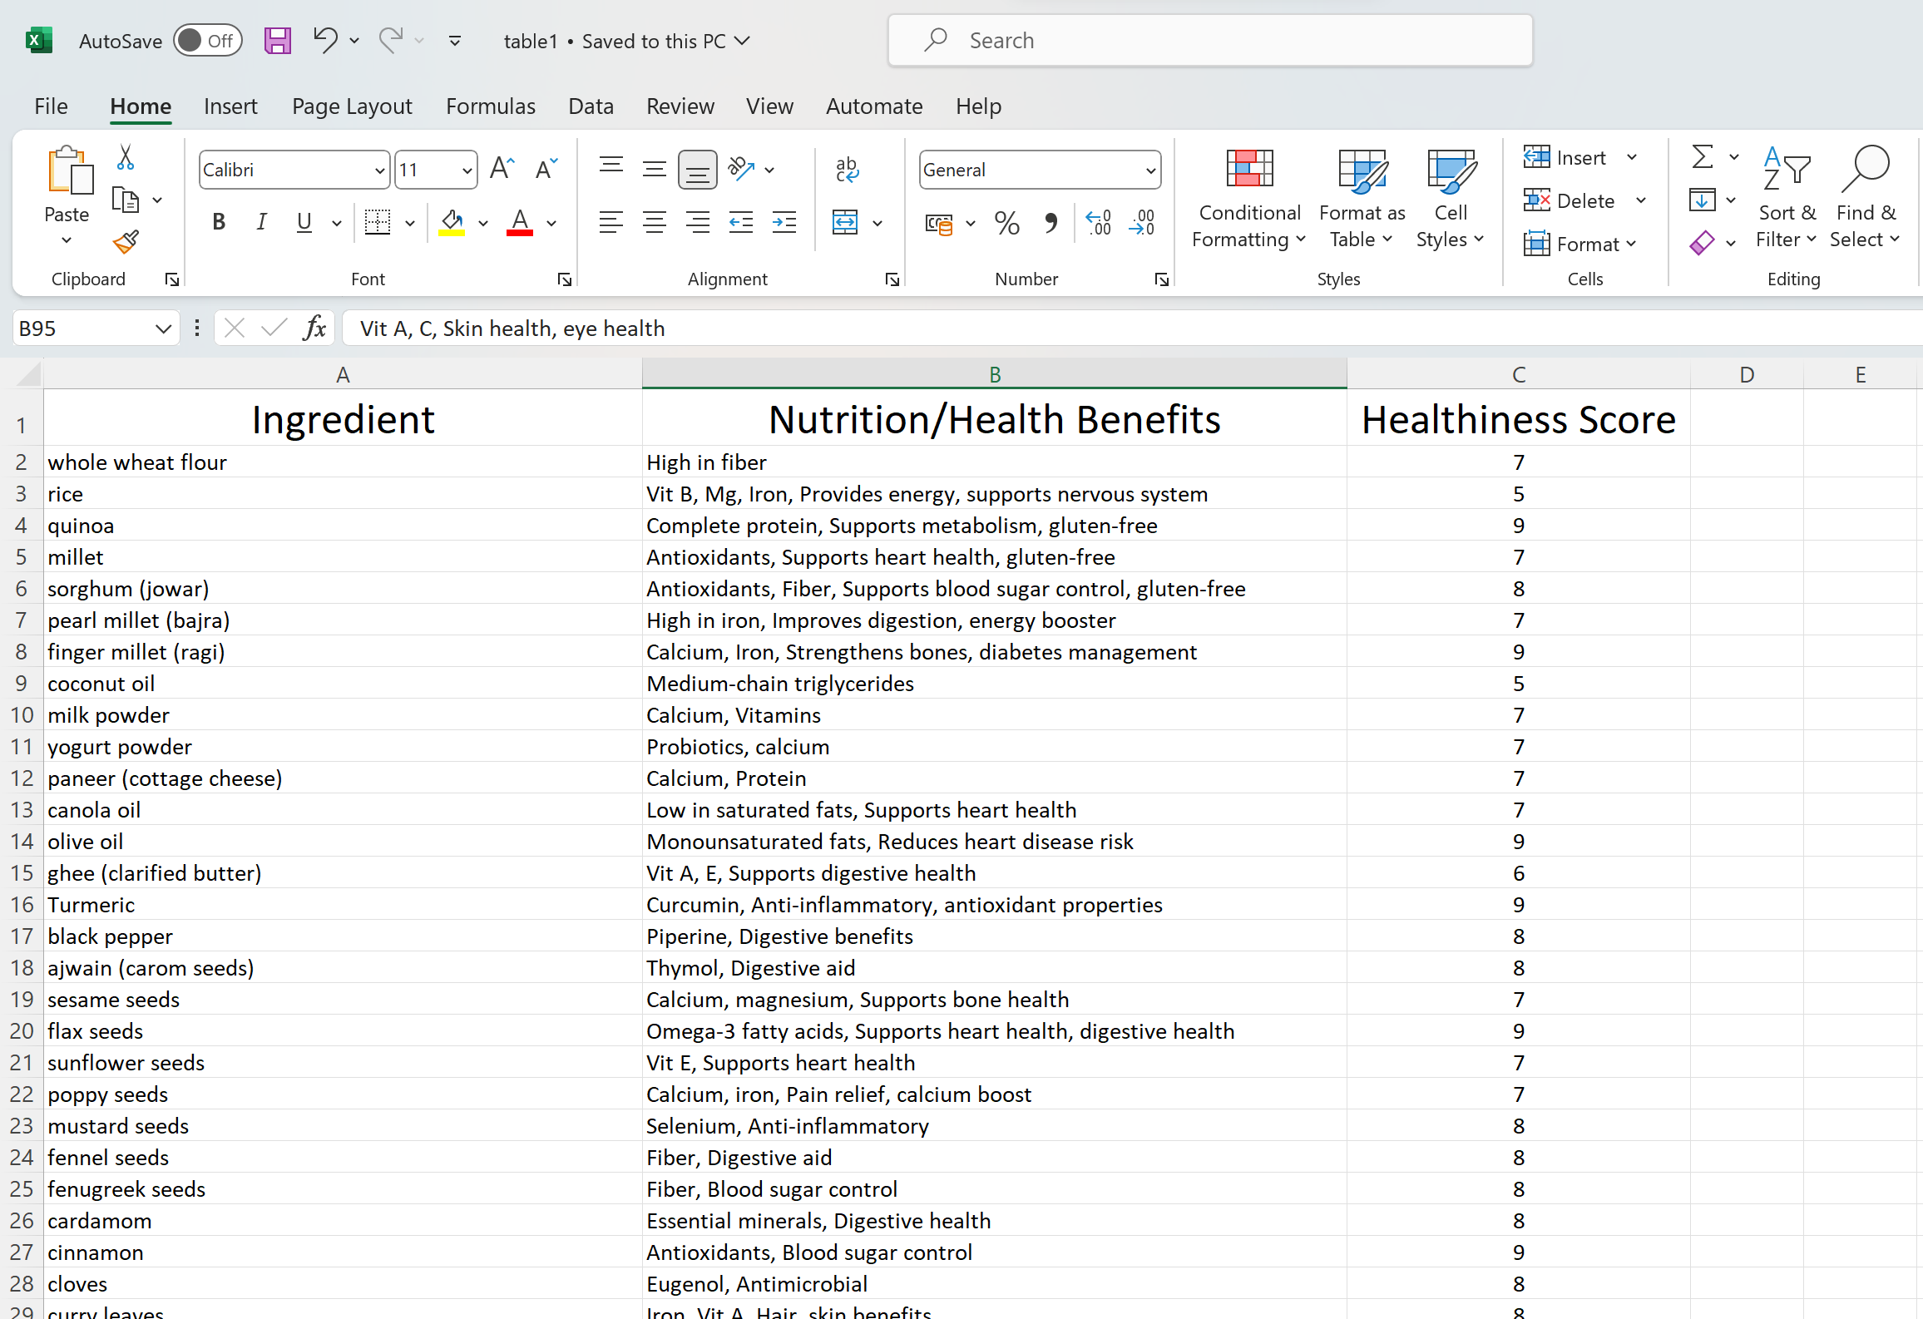

Slide 6
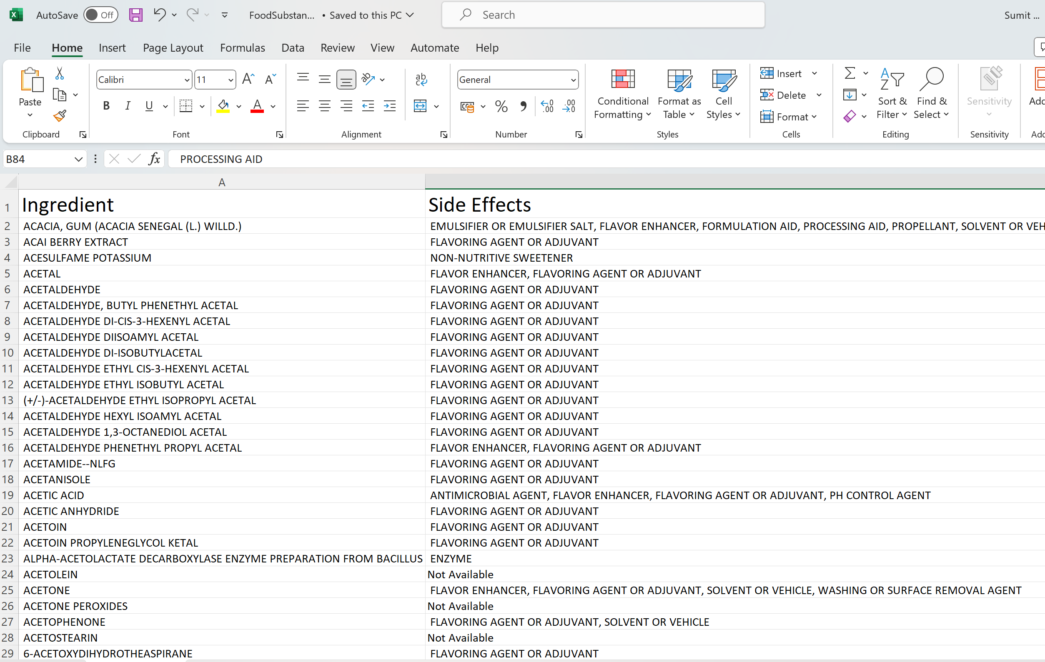

Slide 7
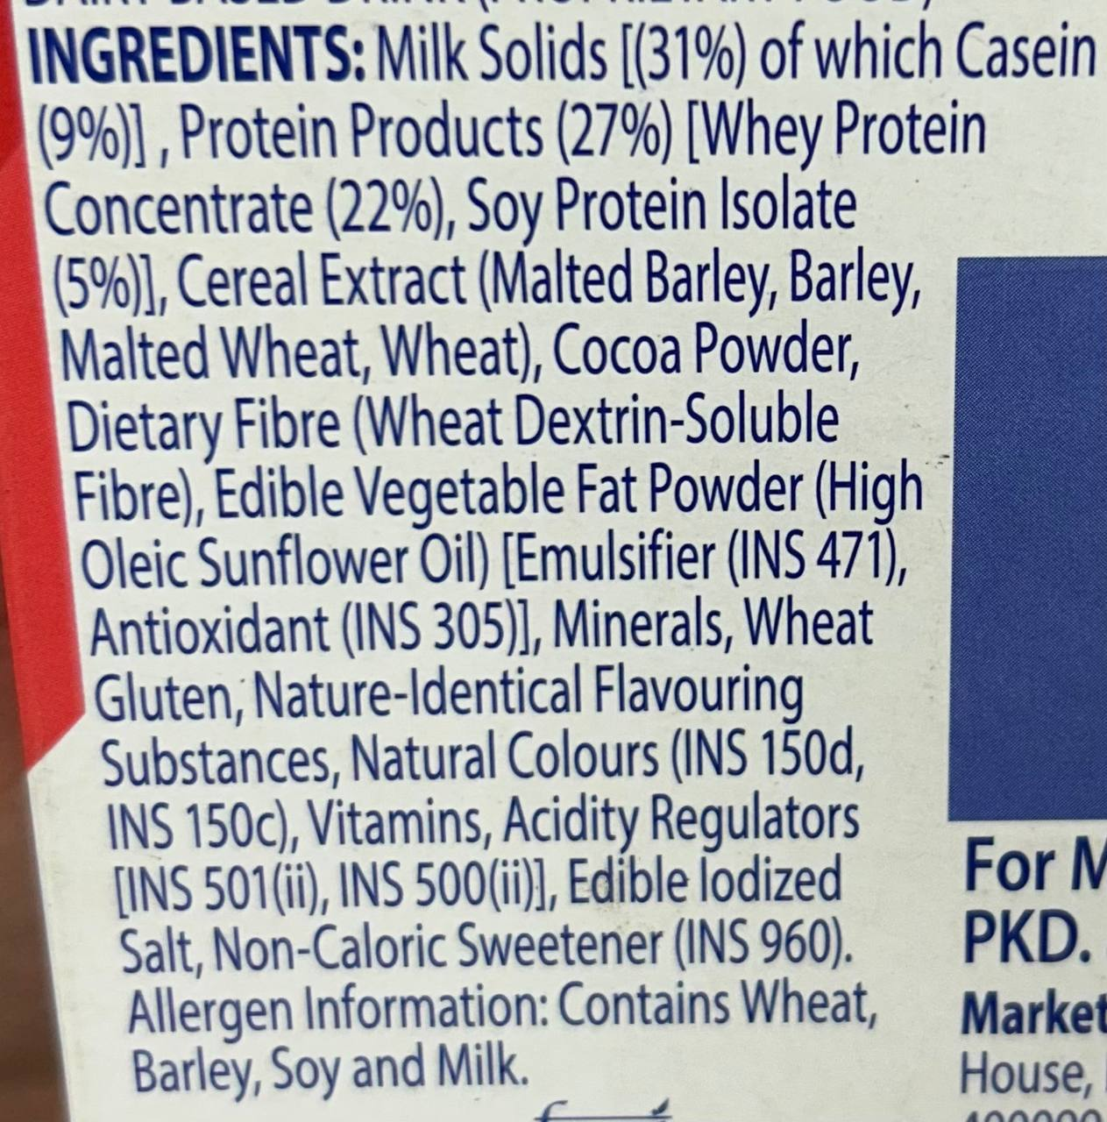
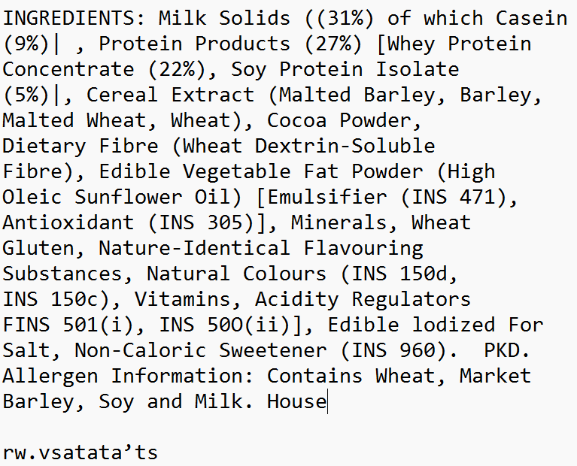
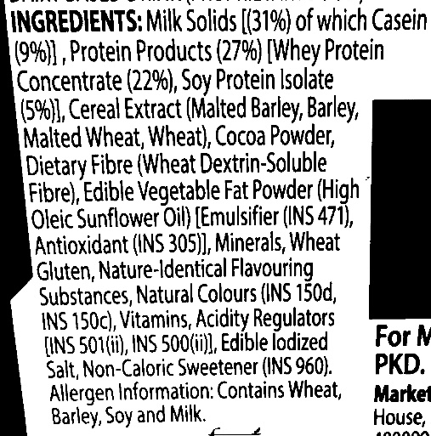
There are datasets used
Table1.csv [for healthy Ingredients]
Table2.csv[for unhealthy Ingredients]
Food Substances[Additives in food products] by https://fdc.nal.usda.gov/
A large database of Image of back side of food products is collected from groceries stores like Reliance Fresh, Jiomart, Big Bazaar, Dmarts etc. to train the model to extract ingredient list efficiently.
Real Image
Grey Scale Conversion
Extraction of txt data

Slide 8
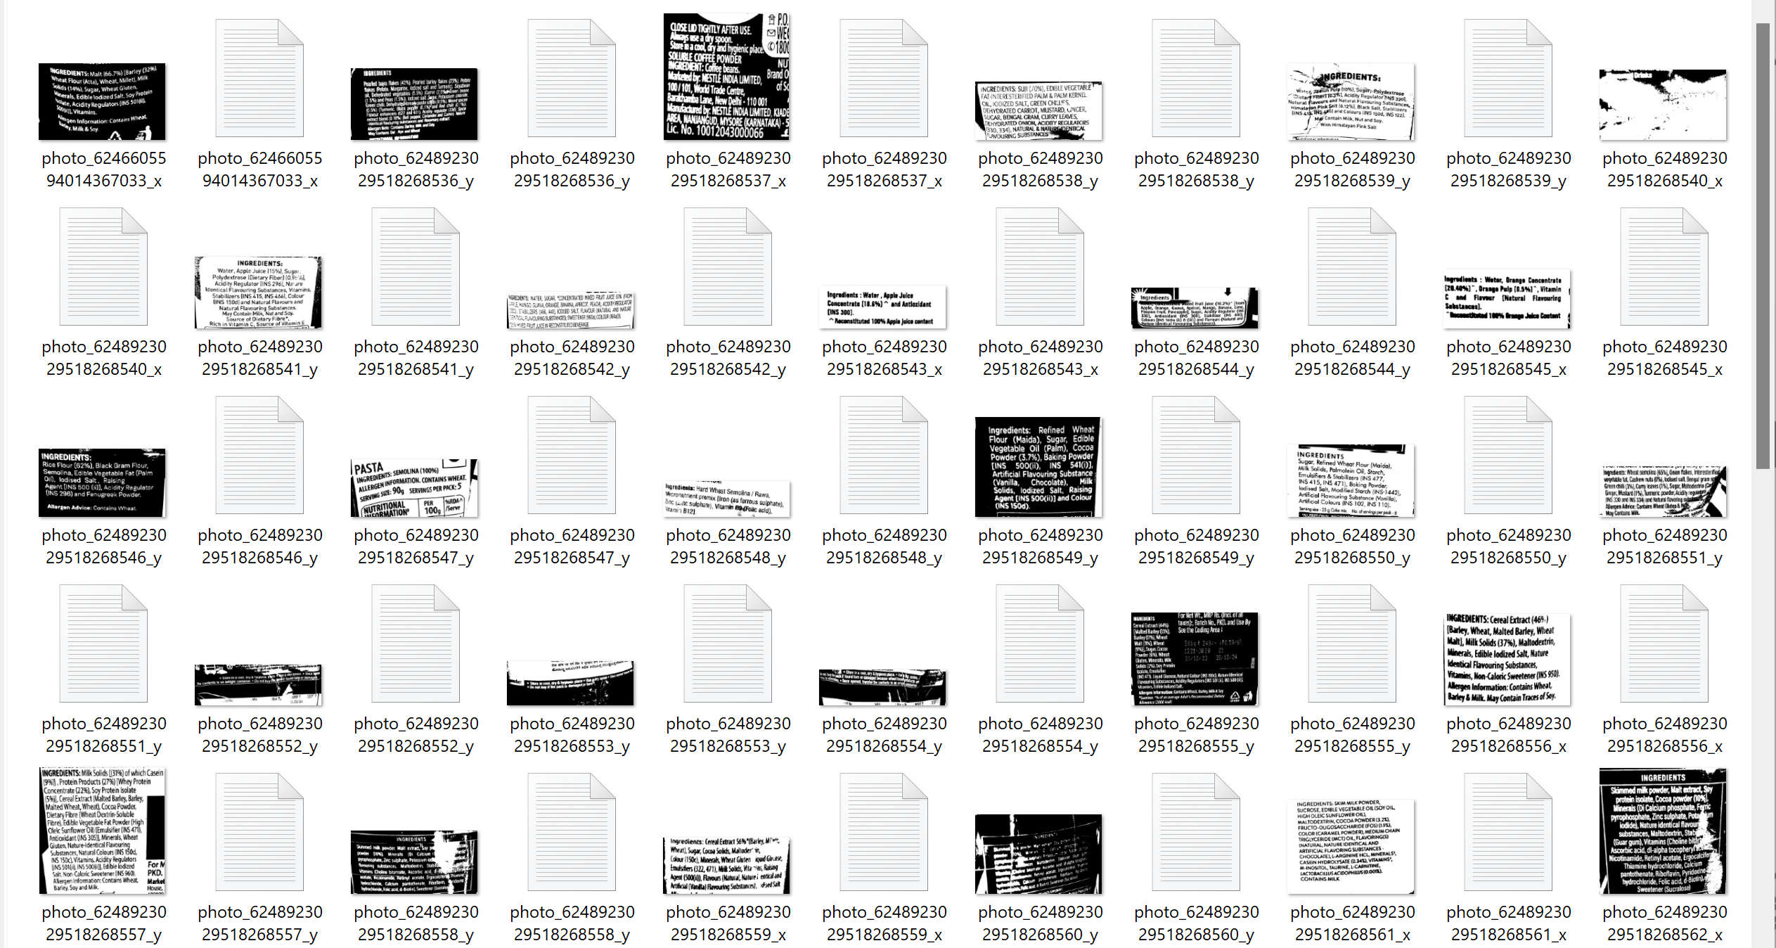

Slide 9

Objectives
To bring a Transition in Human Life through Awareness of their Consumption.
To make an effective use of AI Search Algorithms like VSM, TF-IDF and Thresholding.
To generate a accurate and concise Healthiness Report.
To create a tempting User Interface so that all sections of people from kids to elderly can use it.
To continuously develop and add more features to the model and bring updates.

Slide 10
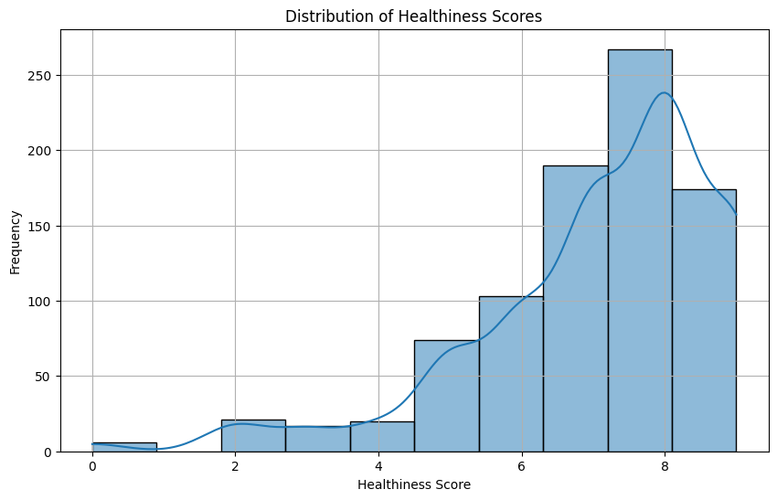
Graph
Fig: This is the distribution of Healthiness Score of all the ingredients present in dataset

Slide 11
Methodology used
The user scans or upload the image of ingredient list present in products
This input data preprocesses like convert to grey scale, reshape, OCR techniques etc.
Text is extracted from the image and then normalized and applied various NLP techniques
AI Search Algorithms are applied like:
1. Vector Space Model (VSM): It is a technique used in information retrieval and text mining. It represents text documents as vectors in a multidimensional space, where each dimension corresponds to a separate term. Similarity measures, such as cosine similarity, are then used to determine the relevance of documents to a query.
2. Term Frequency-Inverse Document Frequency (TF-IDF): It is a numerical statistic intended to reflect how important a word is to a document in a collection or corpus.
This step play a critical role in finding the ingredients (and their forms) from the dataset
Example: onion powder, dehydrated onion are the same ingredient.
The information is presented in form of Report and a Healthiness Percentage as the outcome.

Slide 12
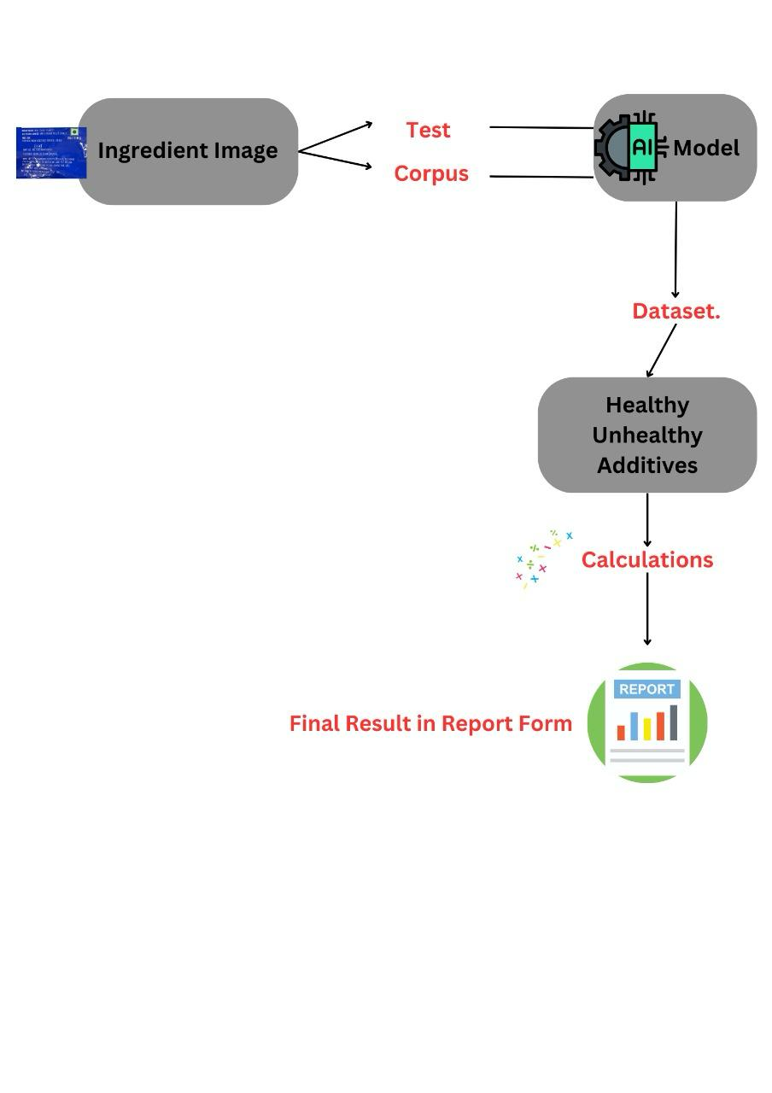
Model Architecture
Real Time
Product Scanning
AI Search Techniques like VSM, TF-IDF
Based on Healthiness Score

Slide 13
USP
Disease Alert Generation
Ingredient Pattern Matching by AI Search (VSM, TF-IDF)
Heathiness Scores

Slide 14
Conclusion & Future Scope:
Food industry is expanding over and over. Businesses will never stop launching new products in the market, but Its all on us how to judiciously analyze the pros and cons of what inside, Healthify is the best companion.
The rigorous analysis of all the ingredients present, and alert for those people suffering from any disease to check the health risks of that product, It can save lives.
Thus, Effective and a good diet always tends to a brighter future. Its high time to think on oneself. Your body will thank you!

Slide 15
Thank You
contact: 9588752520
21BCS6738@cuchd.in
https://www.linkedin.com/in/sumit-miglani-2505-cu

